Slide 1


Multi Model Camera-based Human Activity Monitoring
Anusuya Manickavasagam - A0163300Y, Muni Ranjan - A0163382E Pradeep Kumar - A0163453H, Kesavan Sridhar – A0163207M
ISS-TJ

Slide 2

AGENDA
Agenda
Recap
Objectives
High Level System Diagram
HMM Classification Module
Front End Development
Demo
Current challenges
Future Improvements
Agenda for the day

Slide 3
RECAP
RECAP
Purchase and setup Intel Depth Camera
Explore the Intel Upboard
Setup SDK and Camera connections
Do initial Video streaming and analysis
Differentiate between Active/Not Active users
Explore Smart Monitoring Capabilities using the Intel Depth Camera

Slide 4
Objectives
Objectives
Based on learnings from past Re-define the System use cases
Implement the module for classification
Re-construct the Webapp to cater to use cases
Paper to publish for Proposed app workflow
Defined the Objectives for the IW2

Slide 5

Business Research

Slide 6

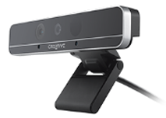
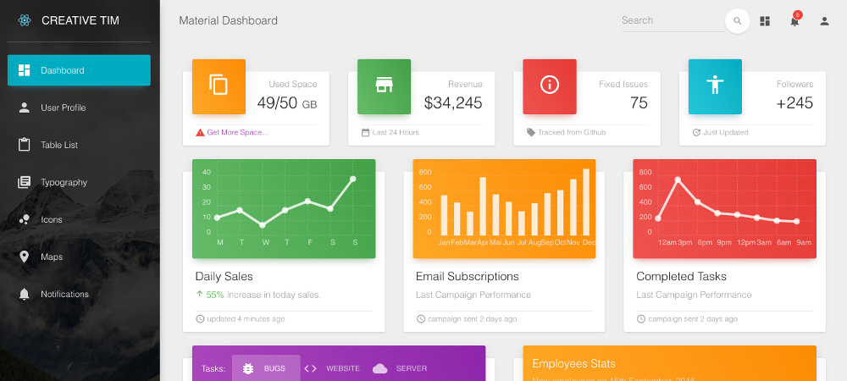

Business Research
Depth camera
Server (desktop)
Collect
Detect
Save
Dashboard
Present
PHYSIOTHERAPEUTIC
PATIENTS ACTIVITIY

Slide 7
User Workflow
Doctor prescribe activities goals (Hospital or in-Home)
Patient performs in front of Smart device
Device collect data (Privacy safe)
Server performs Data Op
Dashboard provide interface to maintain and present data

Slide 8
User Workflow
Capture the depth camera video for model classification
Capture stream by obscuring the details for Person privacy
Raise an alert if person has not performed the activity as per goals
Ability to query by Admin to see if patient perform exercises
Ability to send SMS to registered number

Slide 9
High Level System Diagram

Slide 10
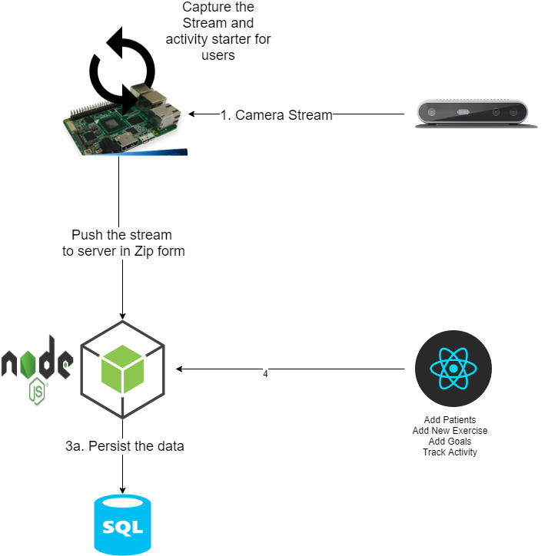
High Level System Diagram

Slide 11
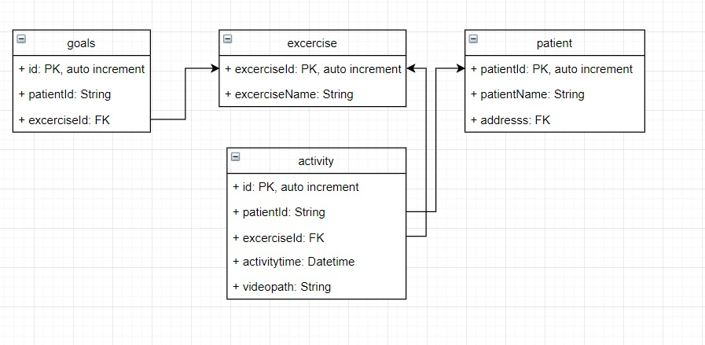
DB Schema

Slide 12
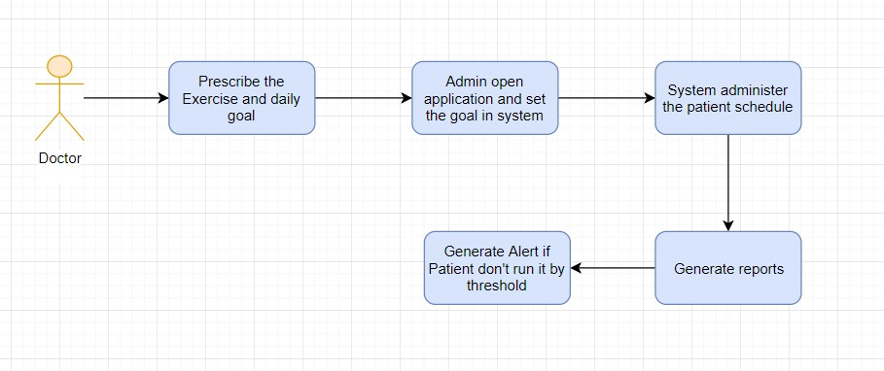
Admin Workflow

Slide 13
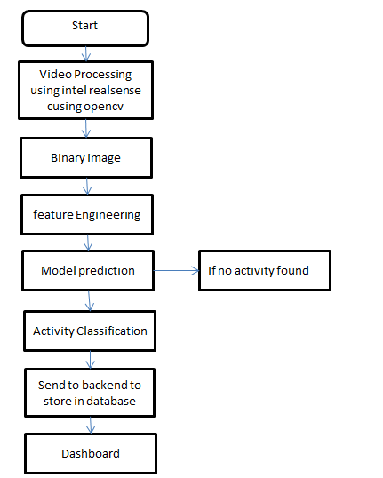
Flow Chart - Classification

Slide 14
Pose Classification Using HMM

Slide 15
Pose Classification using HMM
<TBD – Add lines about HMM>
Trained for the sample of exercise like Head Bend, Situp, Hand raise
Computer Vision capability using OpenCV and Python
Binary Image Frames <what this?>
Alert capability if the goal is not met

Slide 16
Front End Development

Slide 17
Tools & Development
Node JS was used for server backend to capture every second status and the video clip if there is alert
Lightweight SQLite Database
React JS was used for building user interface and thus display in the dashboard real time status(active and inactive)

Slide 18
DEMO

Slide 19
Analysis/Challenges

Slide 20
Analysis
Modelling | Overall System
In general, HMM works pretty good in control environment Modelling is better if trained on full RGB frame like instructor video Prediction could be done using the background subtracted images | Cheaper alternative to Kinect
 | Easy to work for an application such as healthcare in controlled environment
 | Extendable to cater to more use cases

Slide 21
Challenges
Time constraint
Support community for intel board
Exploration of depth features
Poor Skeleton in-accuracies
Application/Overall concept in prototype

Slide 22
Documentation

Slide 23
Documentation
https://bitbucket.org/teamneo/videoanalytics
https://trello.com/#
https://docs.google.com

Slide 24

Thank You

